Slide 1

A Visual Analysis Of TV Shows On
Online Streaming Services
OVERVIEW
TV
Shows
Online
Streaming
Services
5611
4
2
TV Show
Rating
Websites
Age
Groups
5
Spanning
9
Decades
Data Source: This has been downloaded from Kaggle. Below is the link to the data: https://www.kaggle.com/ruchi798/tv-shows-on-netflix-prime-video-hulu-and-disney
38%
90%
81%
of the TV Shows are streamed on Prime Video, followed by Netflix at 34%, Hulu at 31% and the lowest, Disney+ at just 3%, probably as it is only 8 months old. Others are in business for more than 10 years.
of the TV Shows are released in or after 2000. and 75% of the TV Shows were streamed during or after 2010.
Only 0.19% are TV shows from before 1950.
Additionally, 18% of all TV Shows are targeted for 16+ audience.
is the average rating of the TV shows on Disney+ on Rotten Tomatoes, which is the highest. On IMDb, the highest average rating is 7.18% for Prime Videos, closely followed by Netflix at 7.16% and Hulu at 7%.
1

Slide 2

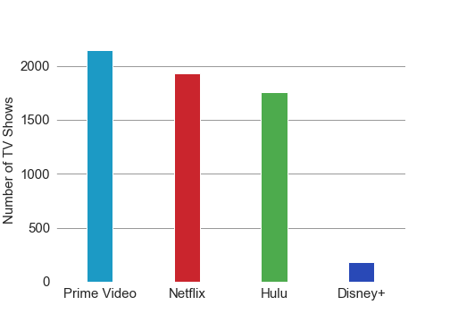
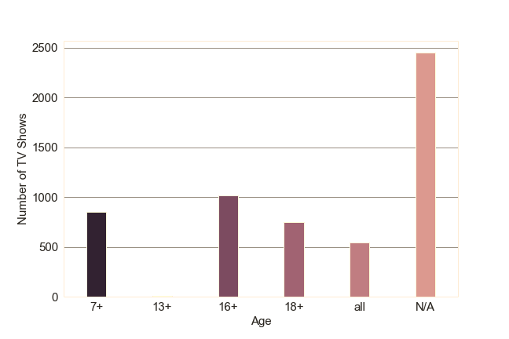
A Visual Analysis Of TV Shows On
Online Streaming Services
Prime Video, Netflix and Hulu are way ahead of Disney+ in terms of number of TV Shows being streamed.
Data Source: This has been downloaded from Kaggle. Below is the link to the data: https://www.kaggle.com/ruchi798/tv-shows-on-netflix-prime-video-hulu-and-disney
Only 10% of the TV Shows are for family entertainment. 23% of the TV Shows whose target age group is known are for adults. Only 4 movies are targeted for the 13+ viewers.
2

Slide 3
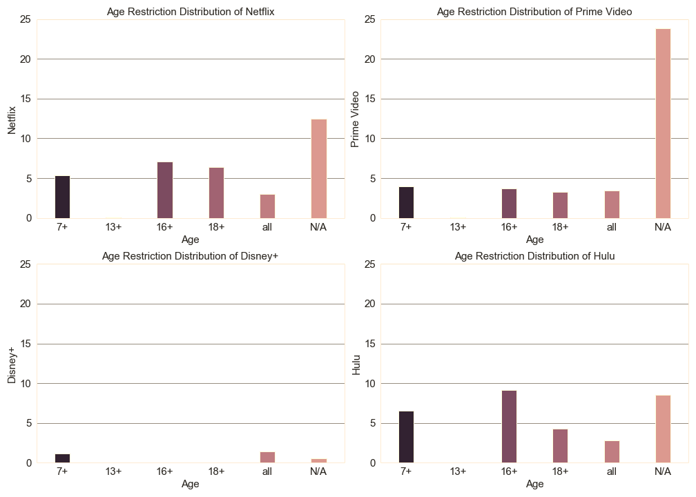
A Visual Analysis Of TV Shows On
Online Streaming Services
Mostly 16+ and 18+ TV Shows
Uniformly distributed except for 13+ age group
Mostly TV Shows are suitable for all ages
Maximum percentage of 16+ TV Shows among all services
Data Source: This has been downloaded from Kaggle. Below is the link to the data: https://www.kaggle.com/ruchi798/tv-shows-on-netflix-prime-video-hulu-and-disney
3

Slide 4
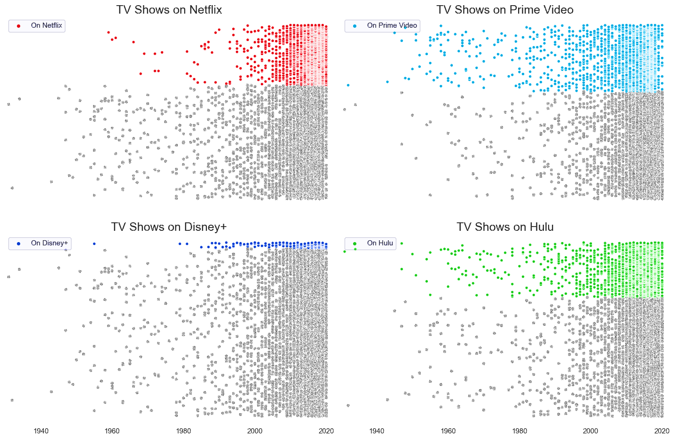
A Visual Analysis Of TV Shows On
Online Streaming Services
TV Shows on Netflix and Disney+ are beyond 1990. Prime Video and Hulu have comparatively more TV Shows from before 1990s. Hulu has the oldest show ‘Betty Boop, M.D.’ which was first aired in 1932.
Data Source: This has been downloaded from Kaggle. Below is the link to the data: https://www.kaggle.com/ruchi798/tv-shows-on-netflix-prime-video-hulu-and-disney
4

Slide 5
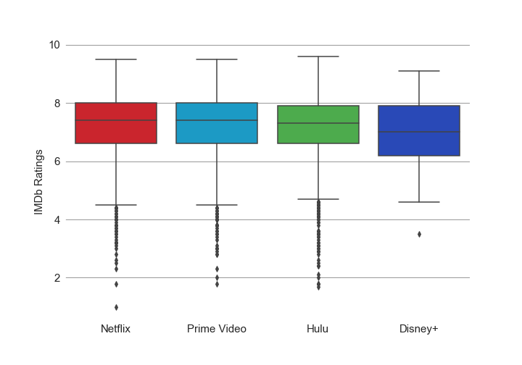
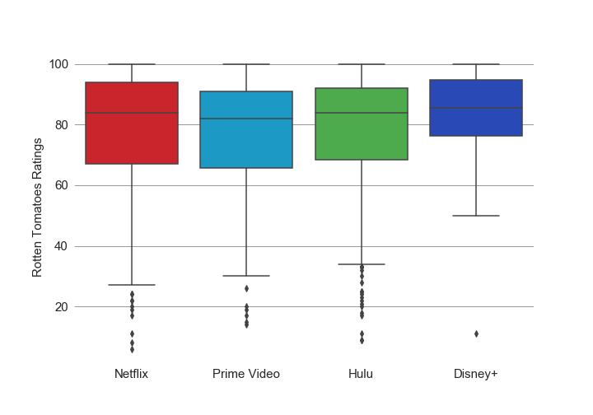
A Visual Analysis Of TV Shows On
Online Streaming Services
The rating distributions of Netflix, Prime
Video and Hulu are almost same for
both IMDb and Rotten Tomatoes.
Data Source: This has been downloaded from Kaggle. Below is the link to the data: https://www.kaggle.com/ruchi798/tv-shows-on-netflix-prime-video-hulu-and-disney
Disney+ looks consistent on the quality of TV Shows
5

Slide 6
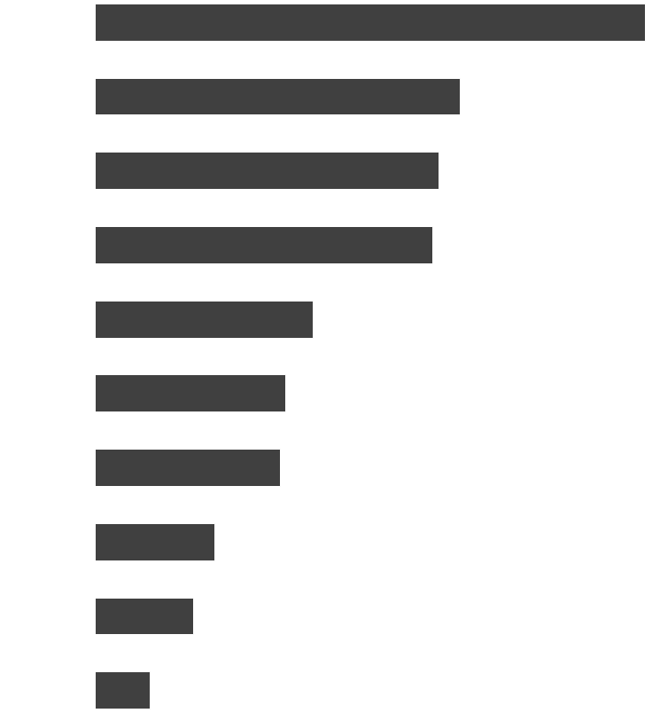
A Visual Analysis Of TV Shows On
Online Streaming Services
Out of
5611
TV Shows
101
LOVE
67
WORLD
63
SHOW
62
LIFE
40
WAR
35
GIRL
34
ADVENTURE
22
NEW
18
AMERICAN
10
SECRET
Data Source: This has been downloaded from Kaggle. Below is the link to the data: https://www.kaggle.com/ruchi798/tv-shows-on-netflix-prime-video-hulu-and-disney
5

Slide 7
A Visual Analysis Of TV Shows On
Online Streaming Services
THANK YOU
5

